Slide 1
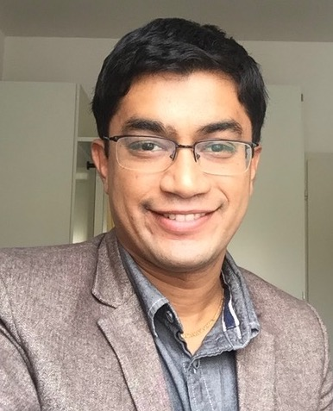
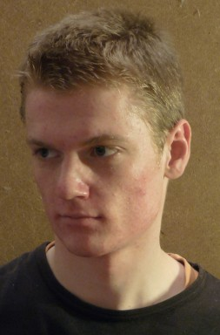
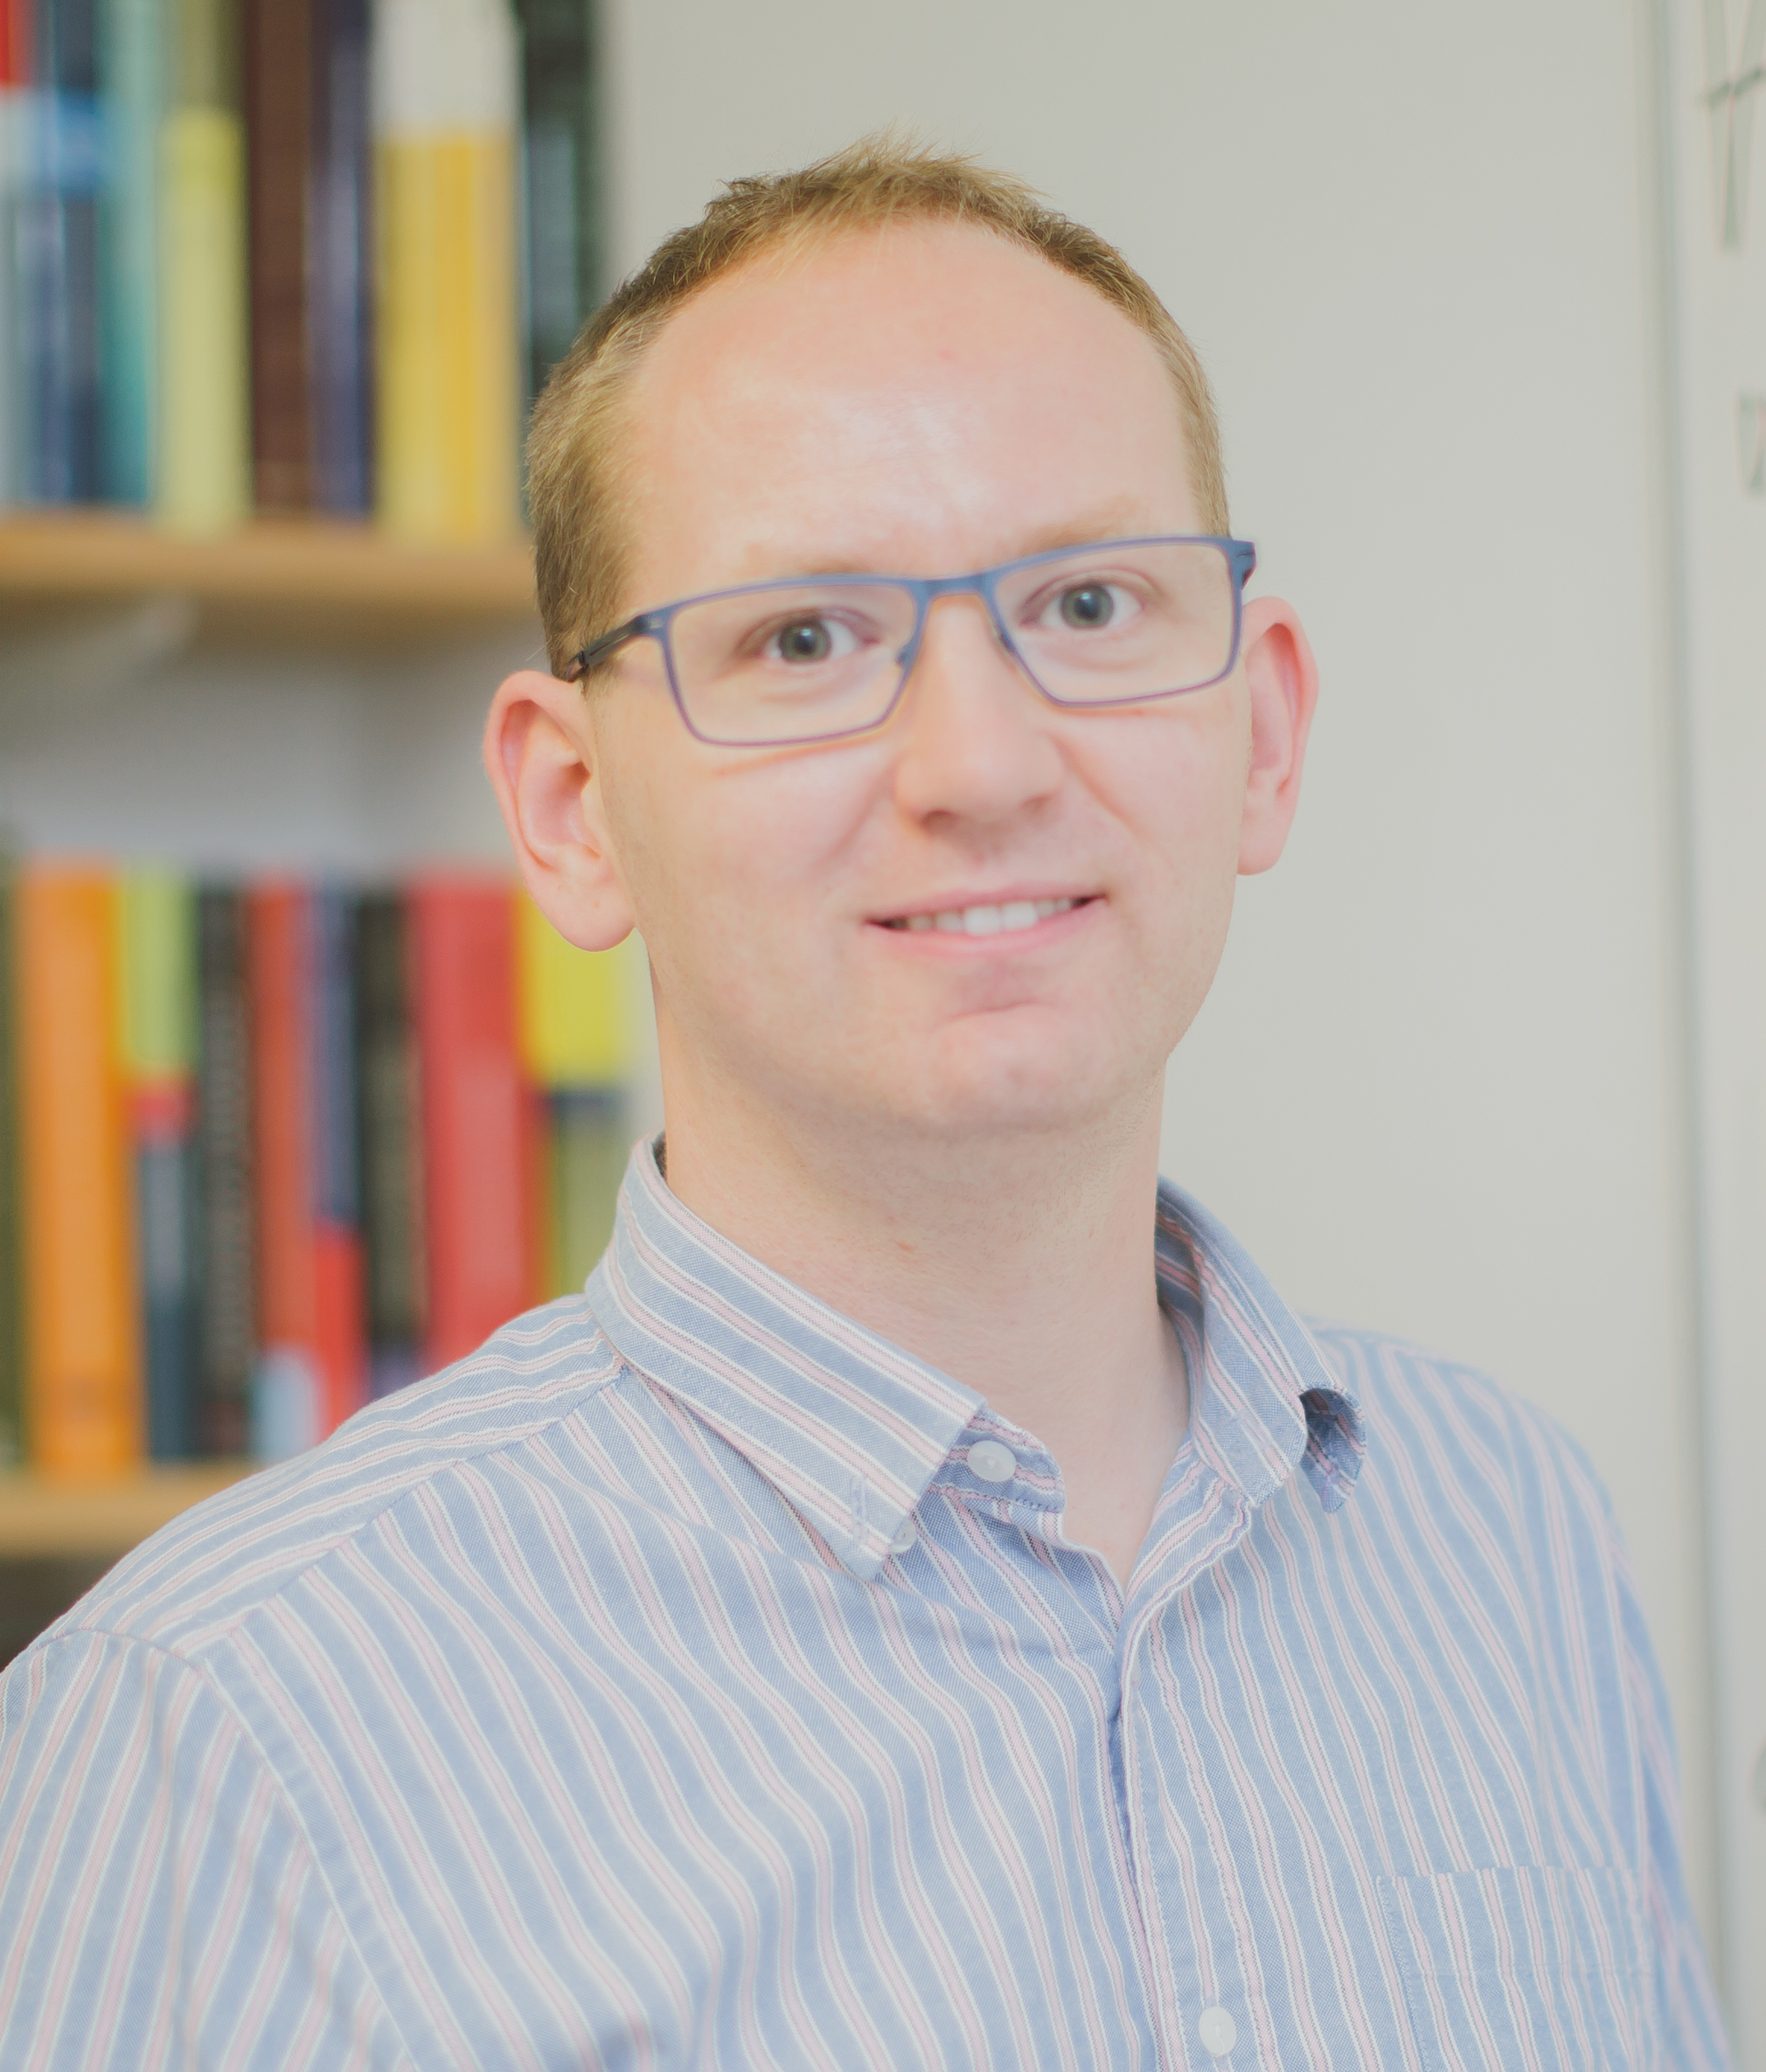
The power of the combined basic LP and affine relaxation for promise CSPs
Joshua Brakensiek (Stanford)
joint work with
Venkatesan Guruswami (CMU), Marcin Wrochna (Oxford), Stanislav Živný (Oxford)

Slide 2
CSPs and relatives
CSP
VCSP
PCSP
QCSP
#CSP
PVCSP

Slide 3
Agenda
Overall goal: Understand a simple, principle algorithm for a broad class of (Promise) CSPs.
Promise CSPs and their polymorphisms
The Basic Linear Programming and Affine Relaxations
Analysis for symmetric polymorphisms
Characterizing Power
Concluding Remarks.

Slide 4
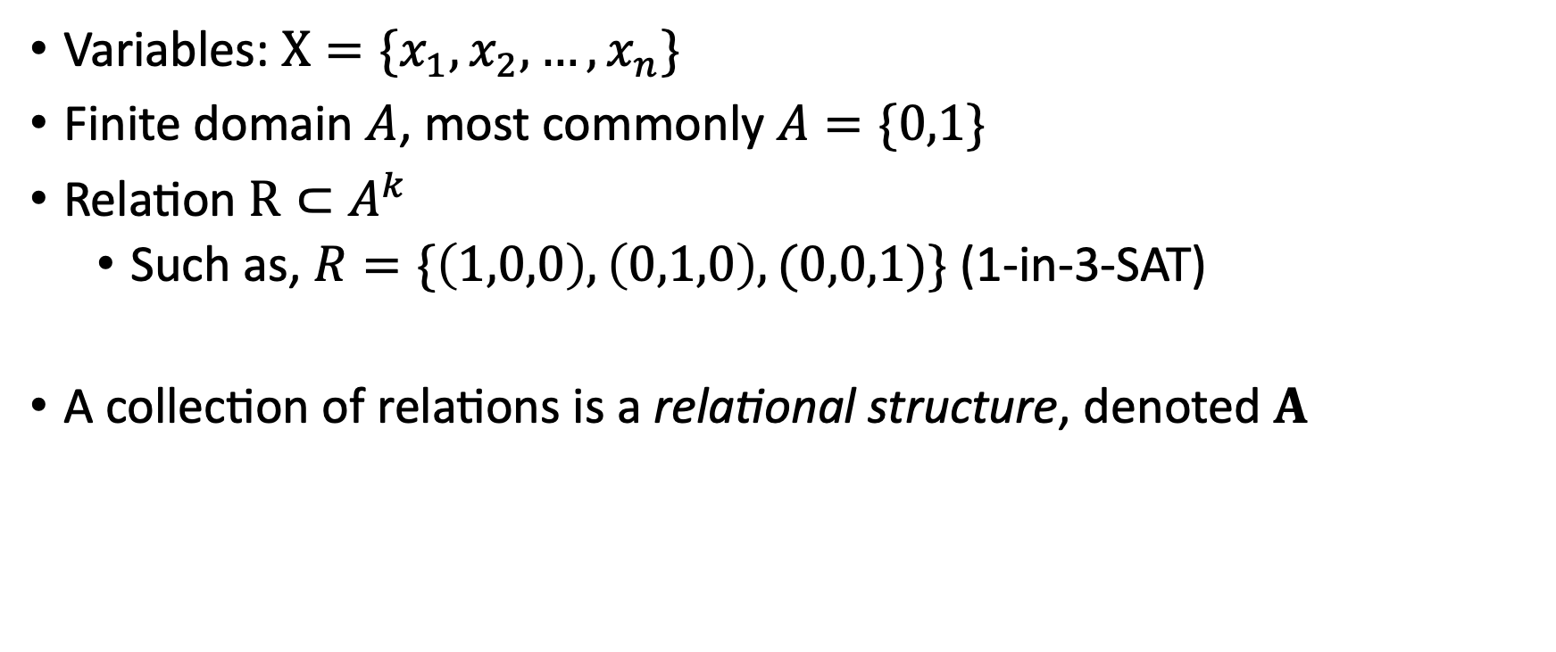
CSP refresher
Variables: $X=\{x_{1}, x_{2},…, x_{n}\}$
Finite domain $A$, most commonly $A=\{0,1\}$
Relation $R⊂A^{k}$
Such as, $R=\{\left(1,0,0\right),\left(0,1,0\right),(0,0,1)\}$ (1-in-3-SAT)
A collection of relations is a relational structure, denoted $A$

Slide 5
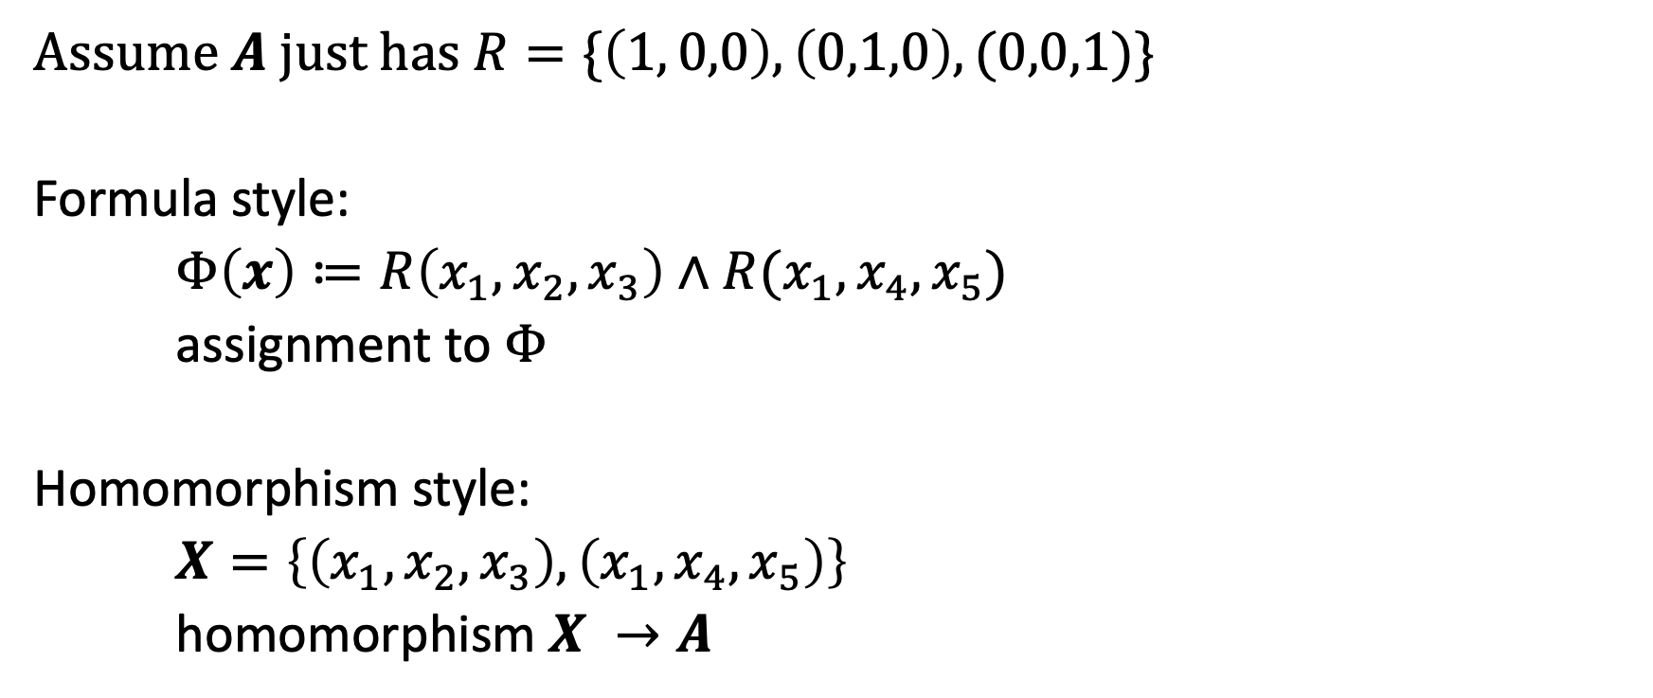
Two kinds of CSP notation
Assume $A$ just has $R=\{\left(1, 0,0\right), \left(0,1,0\right),(0,0,1)\}$
Formula style:
$Φ\left(x\right)≔R\left(x_{1},x_{2},x_{3}\right)∧R(x_{1},x_{4},x_{5})$
assignment to $Φ$
Homomorphism style:
$X=\left\{\left(x_{1},x_{2},x_{3}\right), \left(x_{1},x_{4},x_{5}\right)\right\}$
homomorphism $X →A$

Slide 6
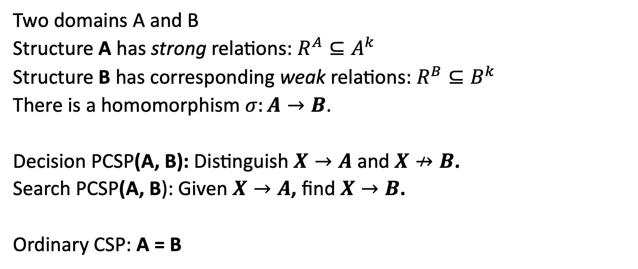
Promise CSPs
Two domains A and B
Structure A has strong relations: $R^{A}⊆A^{k}$
Structure B has corresponding weak relations: $R^{B}⊆B^{k}$
There is a homomorphism $σ:A→B$.
Decision PCSP(A, B): Distinguish $X→A$ and $X↛B$.
Search PCSP(A, B): Given $X→A$, find $X→B$.
Ordinary CSP: A = B

Slide 7
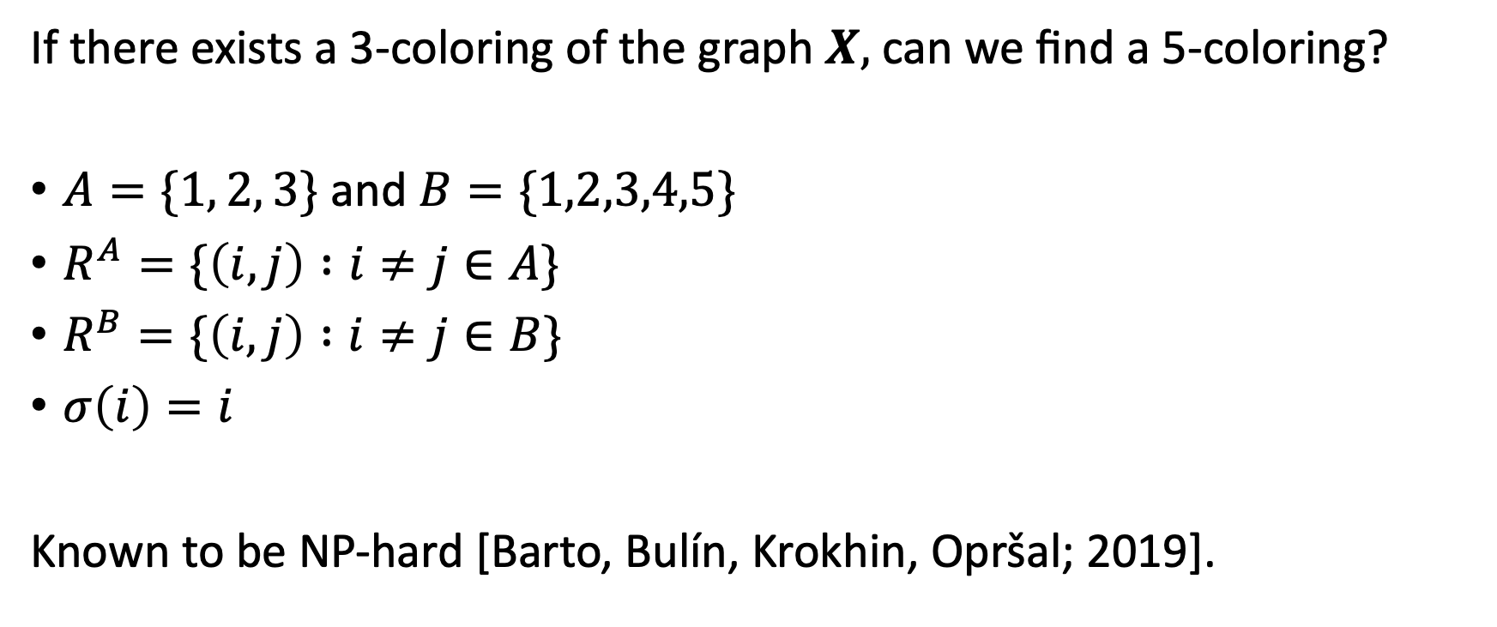
Example: Approximate graph coloring
If there exists a 3-coloring of the graph $X,$ can we find a 5-coloring?
$A=\{1, 2, 3\}$ and $B=\{1,2,3,4,5\}$
$R^{A}=\{\left(i,j\right) :i≠j∈A\}$
$R^{B}=\{\left(i,j\right) :i≠j∈B\}$
$σ\left(i\right)=i$
Known to be NP-hard [Barto, Bulín, Krokhin, Opršal; 2019].

Slide 8
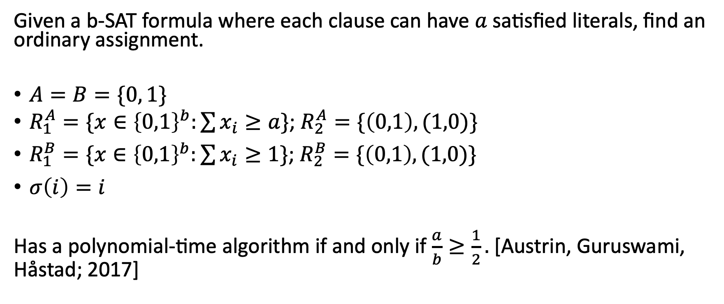
Example: (a,b)-SAT
Given a b-SAT formula where each clause can have $a$ satisfied literals, find an ordinary assignment.
$A=B=\{0, 1\}$
$R_{1}^{A}=\{x∈{\left\{0,1\right\}}^{b}:\sum{x_{i}}≥a\}$; $R_{2}^{A}=\{\left(0,1\right),(1,0)\}$
$R_{1}^{B}=\{x∈{\left\{0,1\right\}}^{b}:\sum{x_{i}}≥1\}\text{; }R_{2}^{B}=\{\left(0,1\right),(1,0)\}$
$σ\left(i\right)=i$
Has a polynomial-time algorithm if and only if $\frac{a}{b}≥\frac{1}{2}.$ [Austrin, Guruswami, Håstad; 2017]

Slide 9
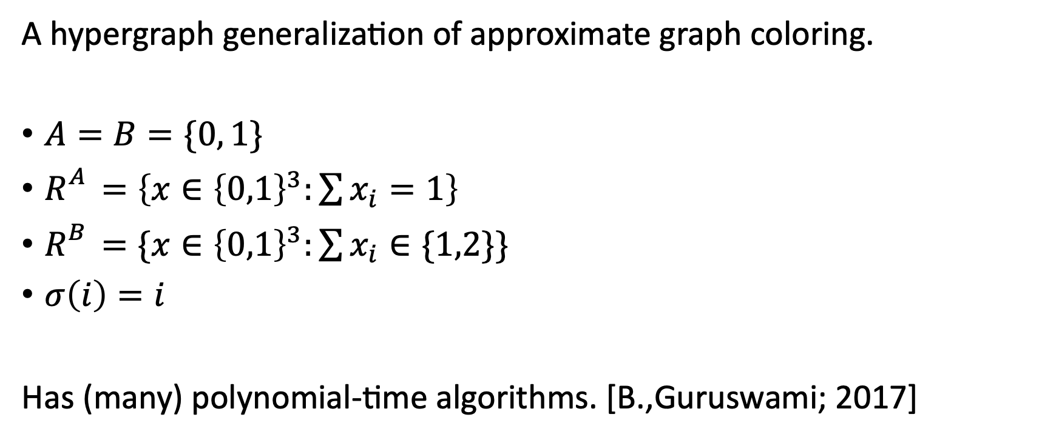
Example: 1-in-3-SAT vs NAE-SAT
A hypergraph generalization of approximate graph coloring.
$A=B=\{0, 1\}$
$R_{}^{A}=\left\{x∈{\left\{0,1\right\}}^{3}:\sum{x_{i}}=1\right\}$
$R_{}^{B}=\{x∈{\left\{0,1\right\}}^{3}:\sum{x_{i}}∈\{1,2\}\}$
$σ\left(i\right)=i$
Has (many) polynomial-time algorithms. [B.,Guruswami; 2017]

Slide 10
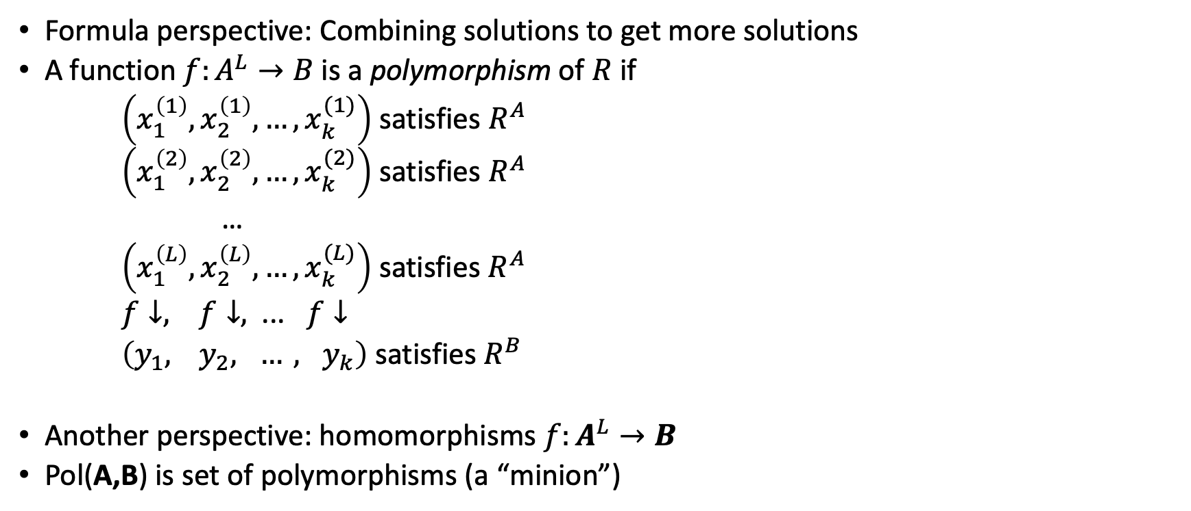
Polymorphisms of (P)CSPs
Formula perspective: Combining solutions to get more solutions
A function $f:A^{L}→B$ is a polymorphism of $R$ if
$\left(x_{1}^{\left(1\right)},x_{2}^{\left(1\right)},…, x_{k}^{(1)}\right)$ satisfies $R^{A}$
$\left(x_{1}^{\left(2\right)},x_{2}^{\left(2\right)},…, x_{k}^{(2)}\right)$ satisfies $R^{A}$
…
$\left(x_{1}^{\left(L\right)},x_{2}^{\left(L\right)},…, x_{k}^{(L)}\right)$ satisfies $R^{A}$
$f↓, f↓,$ ... $f↓$
$\left(y_{1}, { y}_{2}, …, y_{k}\right)$ satisfies $R^{B}$
Another perspective: homomorphisms ${f:A}^{L}→B$
Pol(A,B) is set of polymorphisms (a “minion”)

Slide 11
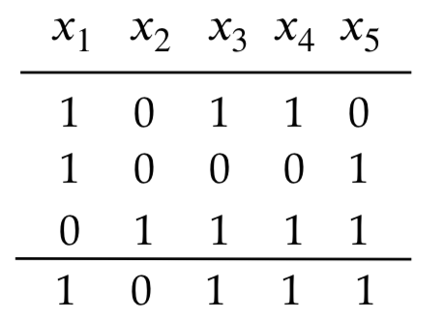
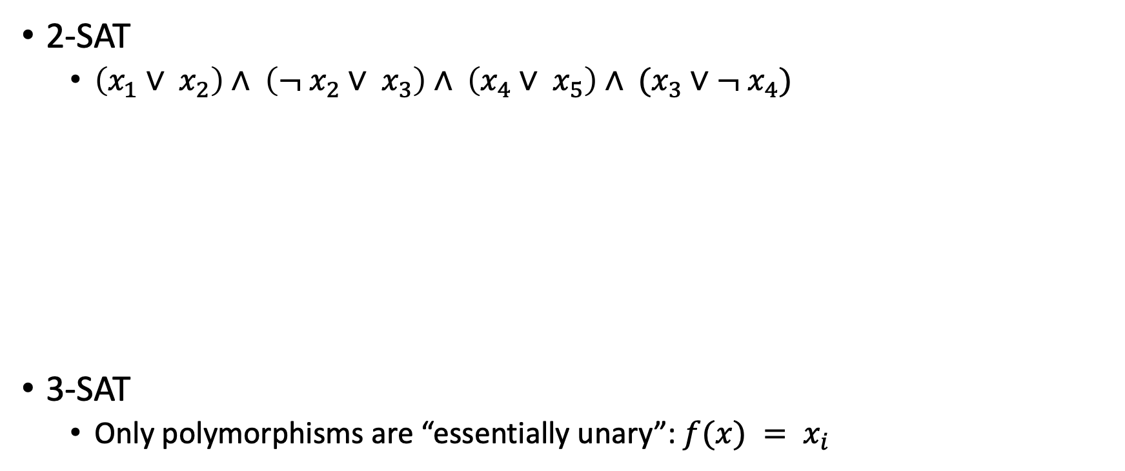
Examples of Polymorphisms
2-SAT
$\left(x_{1}∨ x_{2}\right)∧ \left(¬ x_{2}∨ x_{3}\right)∧ \left(x_{4}∨ x_{5}\right)∧ (x_{3}∨¬ x_{4})$
3-SAT
Only polymorphisms are “essentially unary”: $f(x) = x_{i}$
MAJORITY

Slide 12
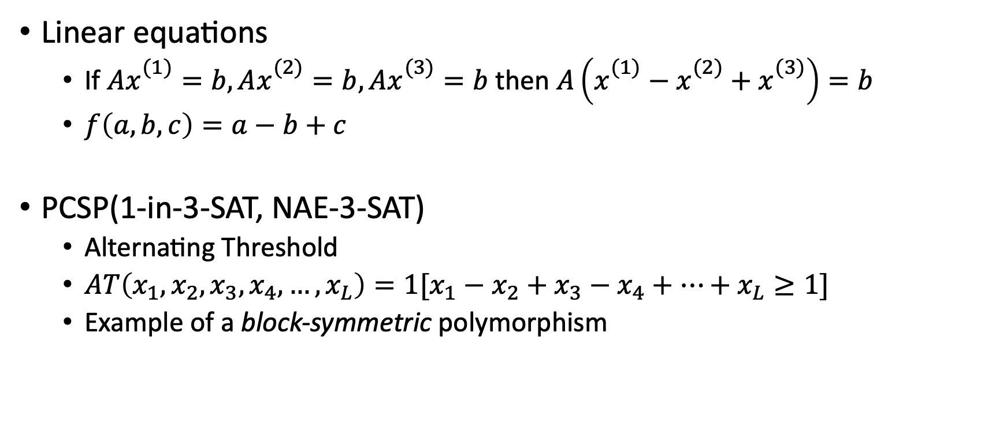
Examples of Polymorphisms
Linear equations
If $Ax_{}^{(1)}=b, Ax_{}^{(2)}=b, Ax_{}^{(3)}=b$ then $A\left(x_{}^{(1)}−x_{}^{(2)}+x_{}^{(3)}\right)=b$
$f\left(a,b,c\right)=a−b+c$
PCSP(1-in-3-SAT, NAE-3-SAT)
Alternating Threshold
$AT\left(x_{1},x_{2},x_{3},x_{4},…, x_{L}\right)=1[x_{1}−x_{2}+x_{3}−x_{4}+…+x_{L}≥1]$
Example of a block-symmetric polymorphism

Slide 13
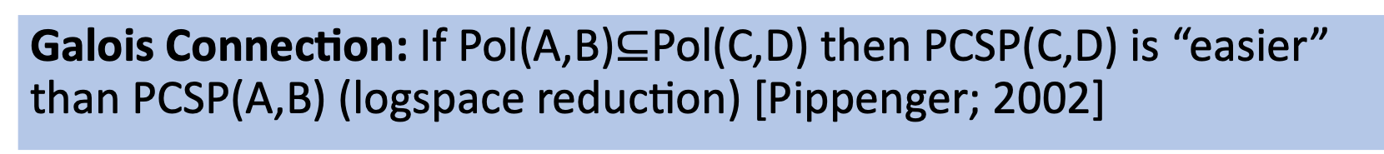
Big Picture
Tractability and polymorphisms go hand-in-hand:
“Symmetric” polymorphisms → tractable
“Skewed” polymorphisms → NP-hard
Galois Connection: If Pol(A,B)$⊆$Pol(C,D) then PCSP(C,D) is “easier” than PCSP(A,B) (logspace reduction) [Pippenger; 2002]

Slide 14
Some past algorithm/dichotomy results for PCSPs
(2+eps)-SAT [Austrin, Guruswami, Håstad; 2017]
Binary Symmetric Relations
Negation assumption [B., Guruswami; 2018]
Fully Dichotomy [Ficak, Kozik, Olšák, Stankiewicz; 2019]
“Threshold-periodic” polymorphisms [B., Guruswami; 2019]
Set-SAT [Brandts, Wrochna, Zivny; 2019]
And others!

Slide 15
Agenda
Overall goal: Understand a simple, principle algorithm for a broad class of (Promise) CSPs.
Promise CSPs and their polymorphisms
The Basic Linear Programming and Affine Relaxations
Analysis for symmetric polymorphisms
Characterizing Power
Concluding Remarks.

Slide 16
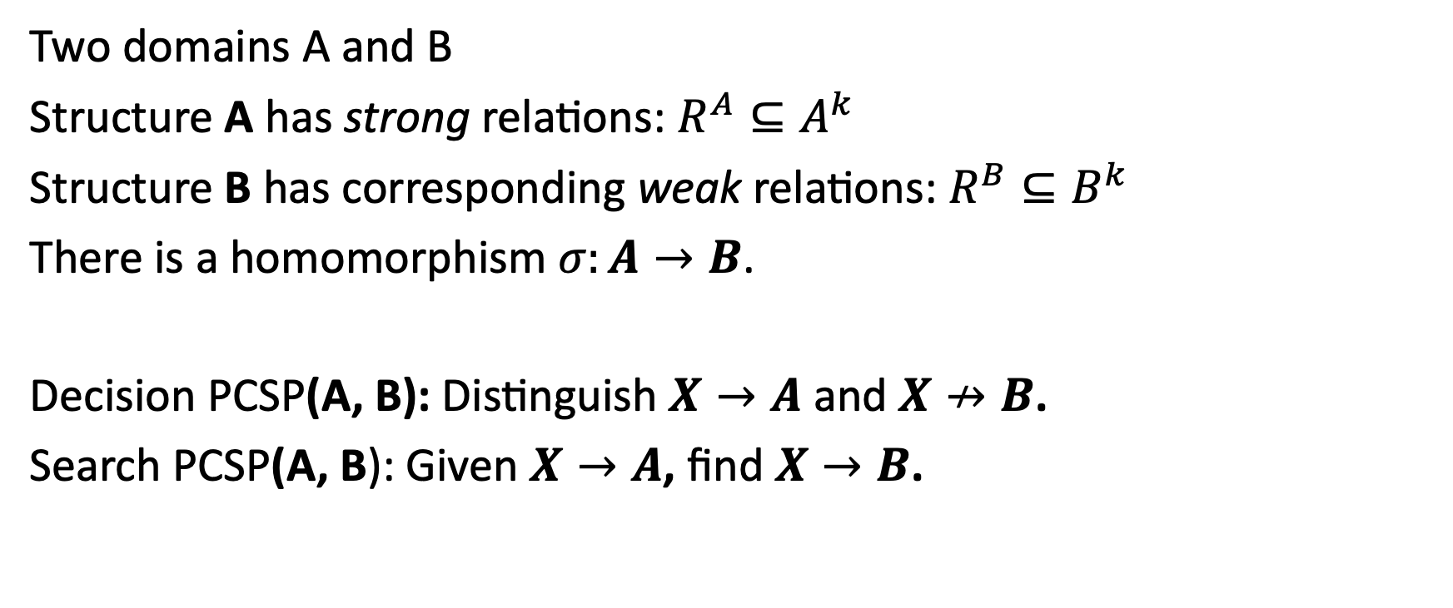
Promise CSPs
Two domains A and B
Structure A has strong relations: $R^{A}⊆A^{k}$
Structure B has corresponding weak relations: $R^{B}⊆B^{k}$
There is a homomorphism $σ:A→B$.
Decision PCSP(A, B): Distinguish $X→A$ and $X↛B$.
Search PCSP(A, B): Given $X→A$, find $X→B$.

Slide 17
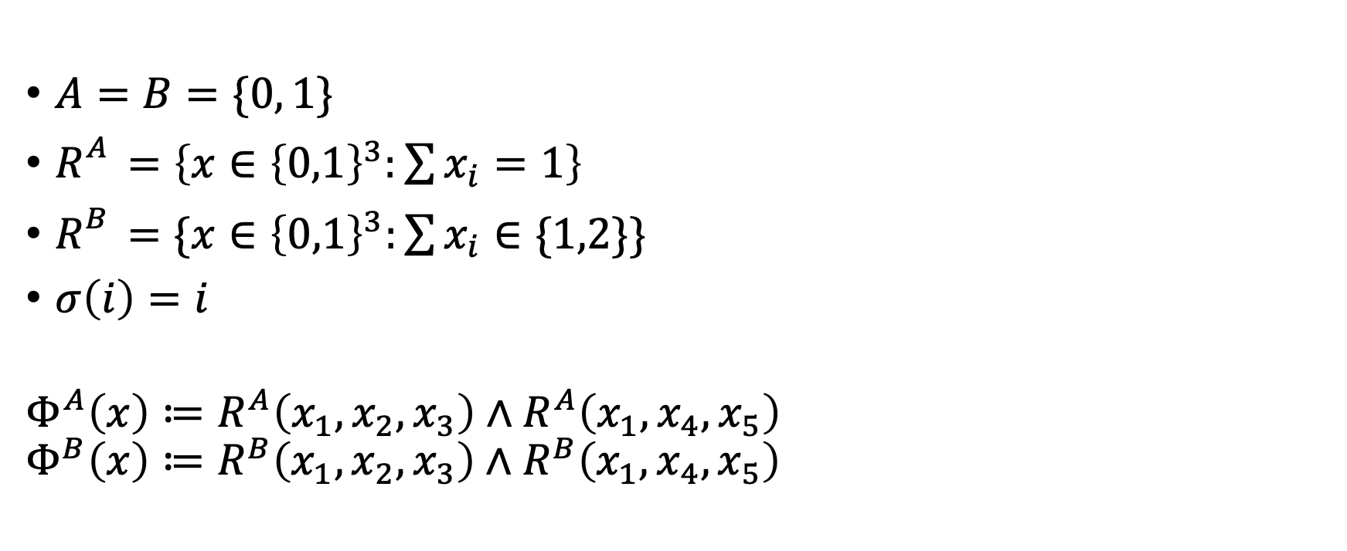
Running Example: 1-in-3-SAT vs NAE-SAT
$A=B=\{0, 1\}$
$R_{}^{A}=\left\{x∈{\left\{0,1\right\}}^{3}:\sum{x_{i}}=1\right\}$
$R_{}^{B}=\{x∈{\left\{0,1\right\}}^{3}:\sum{x_{i}}∈\{1,2\}\}$
$σ\left(i\right)=i$
$$Φ^{A}\left(x\right)≔R^{A}\left(x_{1},x_{2},x_{3}\right)∧R^{A}\left(x_{1},x_{4},x_{5}\right)$$
$$Φ^{B}\left(x\right)≔R^{B}\left(x_{1},x_{2},x_{3}\right)∧R^{B}\left(x_{1},x_{4},x_{5}\right)$$

Slide 18
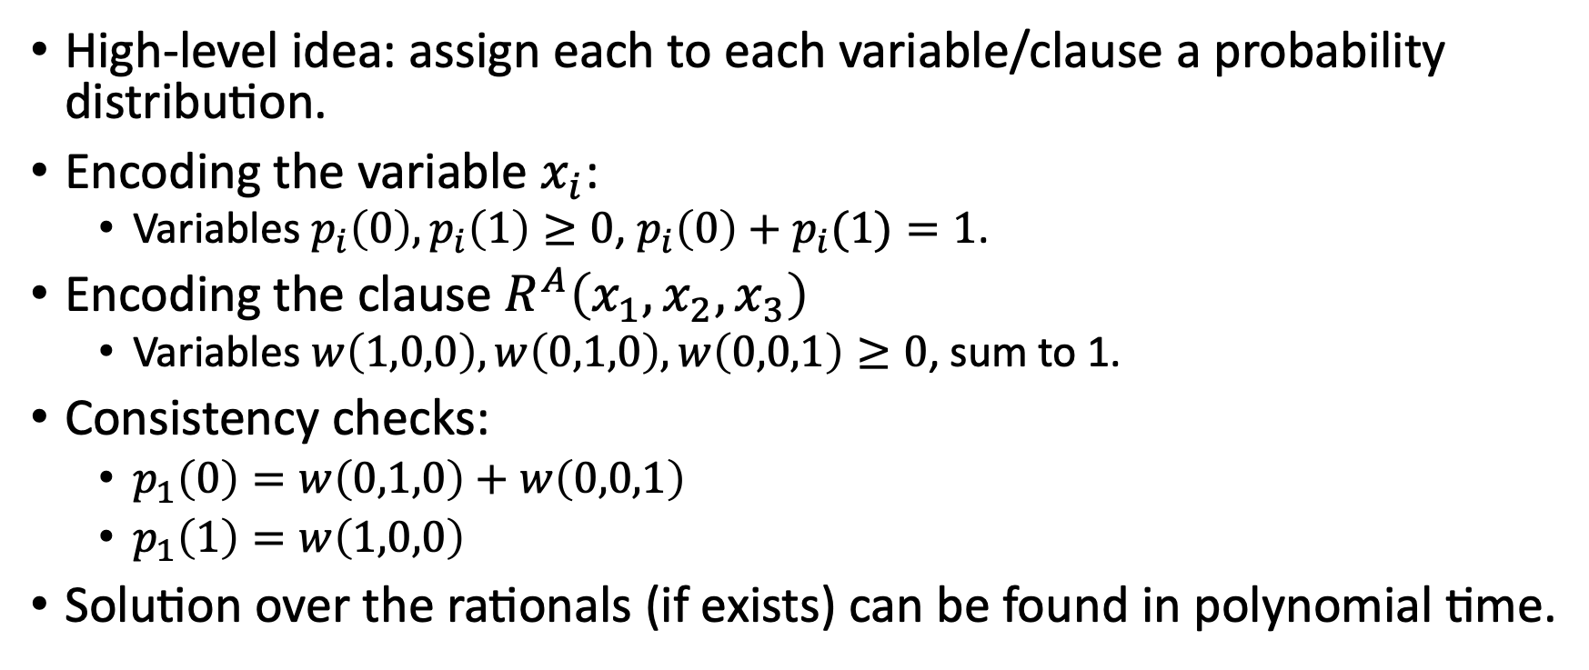
Basic Linear Programming
High-level idea: assign each to each variable/clause a probability distribution.
Encoding the variable $x_{i}$:
Variables $p_{i}\left(0\right), p_{i}\left(1\right)≥0$, $p_{i}\left(0\right)+p_{i}(1)=1$.
Encoding the clause $R^{A}\left(x_{1},x_{2},x_{3}\right)$
Variables $w\left(1,0,0\right), w\left(0,1,0\right), w\left(0,0,1\right)≥0$, sum to 1.
Consistency checks:
$p_{1}\left(0\right)=w\left(0,1,0\right)+w\left(0,0,1\right)$
$p_{1}\left(1\right)=w\left(1,0,0\right)$
Solution over the rationals (if exists) can be found in polynomial time.

Slide 19
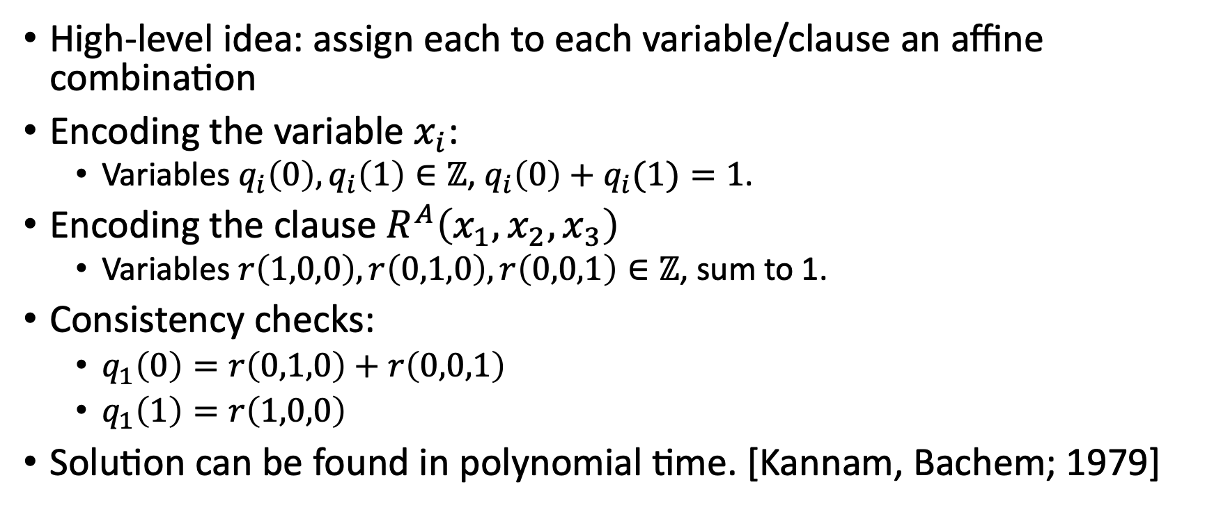
Affine Equations
High-level idea: assign each to each variable/clause an affine combination
Encoding the variable $x_{i}$:
Variables $q_{i}\left(0\right), q_{i}\left(1\right)∈ℤ$, $q_{i}\left(0\right)+q_{i}(1)=1$.
Encoding the clause $R^{A}\left(x_{1},x_{2},x_{3}\right)$
Variables $r\left(1,0,0\right), r\left(0,1,0\right), r\left(0,0,1\right)∈ℤ$, sum to 1.
Consistency checks:
$q_{1}\left(0\right)=r\left(0,1,0\right)+r\left(0,0,1\right)$
$q_{1}\left(1\right)=r\left(1,0,0\right)$
Solution can be found in polynomial time. [Kannam, Bachem; 1979]

Slide 20
Combined algorithm: BLP+Affine
Run the Basic LP algorithm. Reject if no solution.
Run the Affine algorithm. Reject if no solution.
Accept
[There’s a subtle issue, will explain later…]

Slide 21
Agenda
Overall goal: Understand a simple, principle algorithm for a broad class of (Promise) CSPs.
Promise CSPs and their polymorphisms
The Basic Linear Programming and Affine Relaxations
Analysis for symmetric polymorphisms
Characterizing Power
Concluding Remarks.

Slide 22
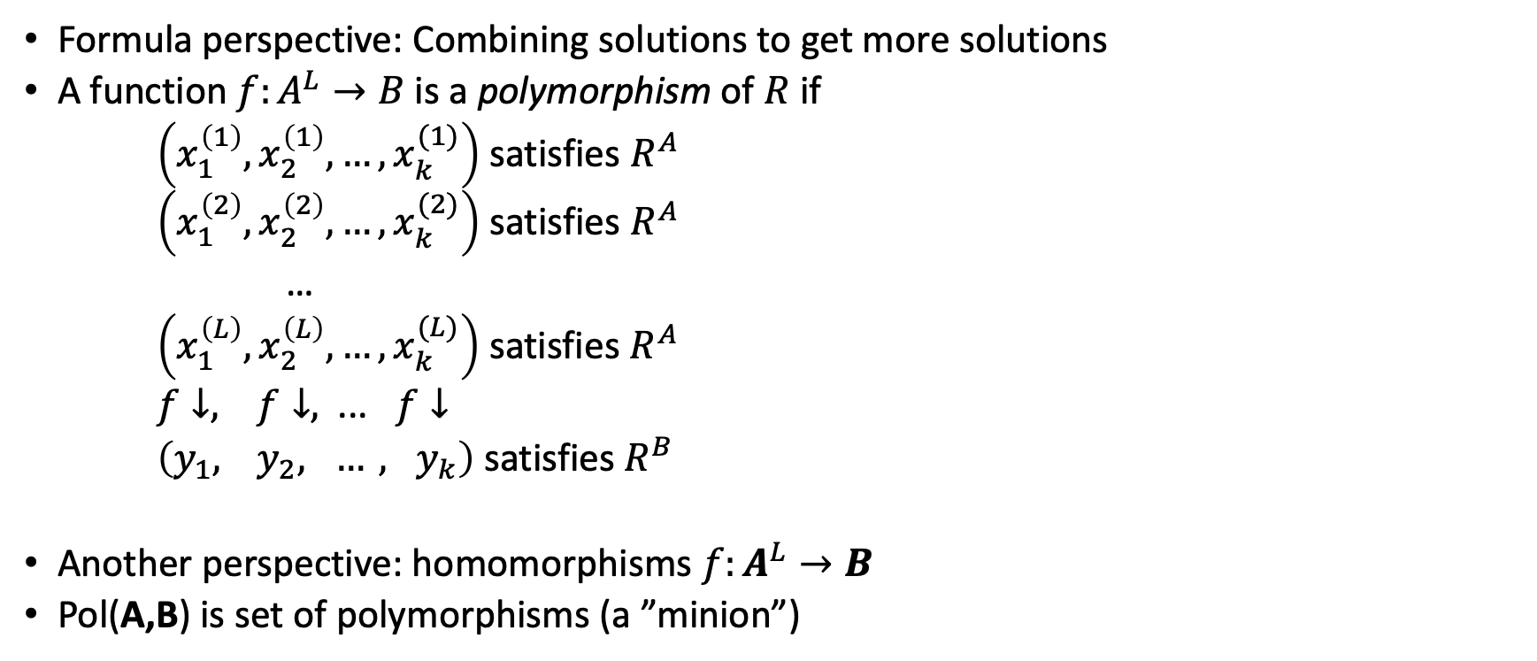
Polymorphisms of (P)CSPs
Formula perspective: Combining solutions to get more solutions
A function $f:A^{L}→B$ is a polymorphism of $R$ if
$\left(x_{1}^{\left(1\right)},x_{2}^{\left(1\right)},…, x_{k}^{(1)}\right)$ satisfies $R^{A}$
$\left(x_{1}^{\left(2\right)},x_{2}^{\left(2\right)},…, x_{k}^{(2)}\right)$ satisfies $R^{A}$
…
$\left(x_{1}^{\left(L\right)},x_{2}^{\left(L\right)},…, x_{k}^{(L)}\right)$ satisfies $R^{A}$
$f↓, f↓,$ ... $f↓$
$\left(y_{1}, { y}_{2}, …, y_{k}\right)$ satisfies $R^{B}$
Another perspective: homomorphisms ${f:A}^{L}→B$
Pol(A,B) is set of polymorphisms (a ”minion”)

Slide 23
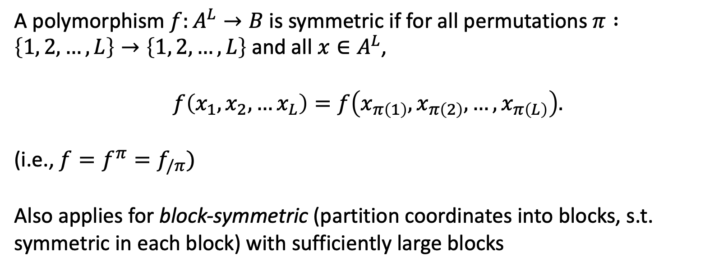
Symmetric Polymorphisms
Theorem: BLP+Affine correctly solves PCSP(A,B) if Pol(A,B) has infinitely many symmetric polymorphisms.
A polymorphism $f:A^{L}→B$ is symmetric if for all permutations $π :\left\{1, 2, …, L\right\}→\left\{1, 2, …, L\right\}$ and all $x∈A^{L}$,
$$f\left(x_{1},x_{2},…x_{L}\right)=f\left(x_{π\left(1\right)},x_{π\left(2\right)},…,x_{π\left(L\right)}\right).$$
(i.e., $f=f^{π}=f_{/π})$
Also applies for block-symmetric (partition coordinates into blocks, s.t. symmetric in each block) with sufficiently large blocks

Slide 24
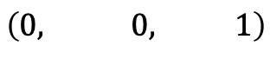
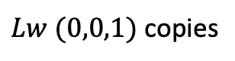
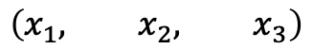
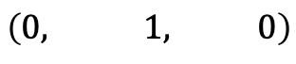
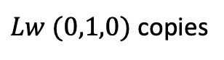

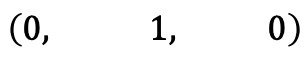
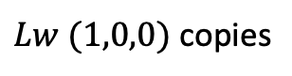
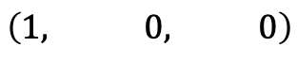
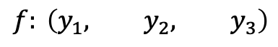
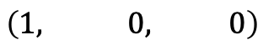
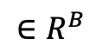
Analysis attempt 1: just BLP
Assumption: Pol(A,B) has infinitely many symmetric polymorphisms.
Pick L sufficiently large such that symmetric $f:A^{L}→B$ is in Pol(A,B)
Look at the clause $R^{A}\left(x_{1},x_{2},x_{3}\right)$
$$\left(x_{1}, x_{2}, x_{3}\right)$$
$$\left(1, 0, 0\right)$$
$Lw (1,0,0)$ copies
$$\left(1, 0, 0\right)$$
$$\left(0, 1, 0\right)$$
$Lw (0,1,0)$ copies
$$\left(0, 1, 0\right)$$
$$\left(0, 0, 1\right)$$
$Lw (0,0,1)$ copies
$$f: \left(y_{1}, y_{2}, y_{3}\right)$$
$${∈R}^{B}$$
$f$ is symmetric, so every output only depends on proportion of 0s/1s in each column

Slide 25
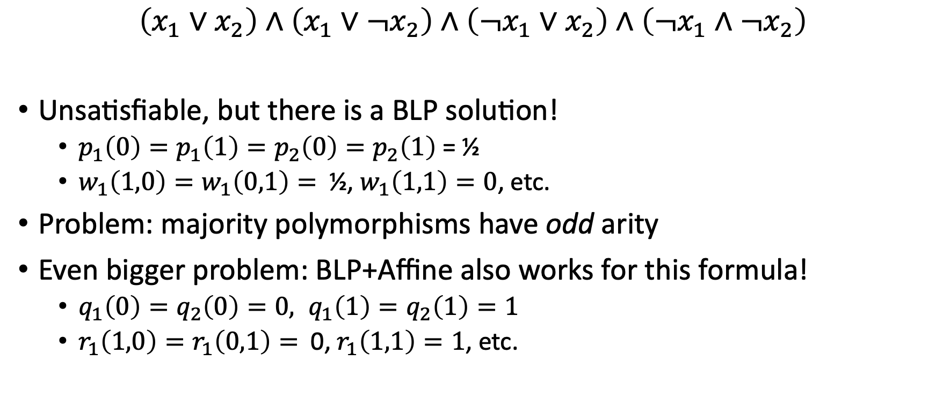
2-SAT counterexample
$$\left(x_{1}∨x_{2}\right)∧\left(x_{1}∨¬x_{2}\right)∧\left({¬x}_{1}∨x_{2}\right)∧\left(¬x_{1}∧{¬x}_{2}\right)$$
Unsatisfiable, but there is a BLP solution!
$p_{1}\left(0\right)=p_{1}\left(1\right)=p_{2}\left(0\right)=p_{2}\left(1\right)$ = ½
$w_{1}\left(1,0\right)=w_{1}\left(0,1\right)=$ ½, $w_{1}\left(1,1\right)=0$, etc.
Problem: majority polymorphisms have odd arity
Even bigger problem: BLP+Affine also works for this formula!
$q_{1}\left(0\right)=q_{2}\left(0\right)=0, q_{1}\left(1\right)=q_{2}\left(1\right)=1$
$r_{1}\left(1,0\right)=r_{1}\left(0,1\right)=$ 0, $r_{1}\left(1,1\right)=1$, etc.

Slide 26
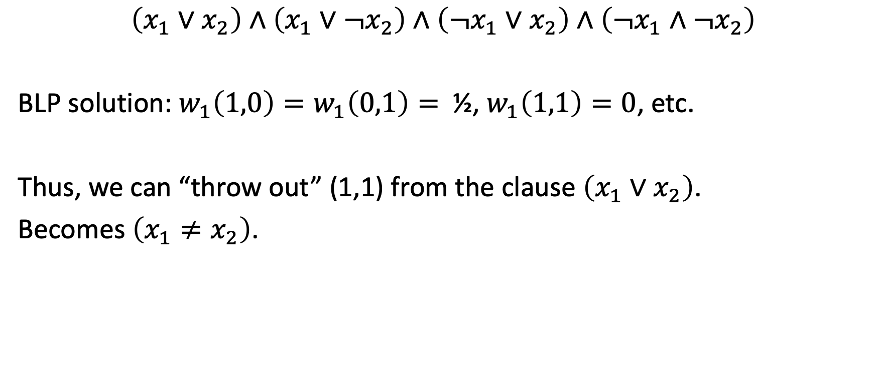
Key Idea: Refinement
$$\left(x_{1}∨x_{2}\right)∧\left(x_{1}∨¬x_{2}\right)∧\left({¬x}_{1}∨x_{2}\right)∧\left(¬x_{1}∧{¬x}_{2}\right)$$
BLP solution: $w_{1}\left(1,0\right)=w_{1}\left(0,1\right)=$ ½, $w_{1}\left(1,1\right)=0$, etc.
Thus, we can “throw out” (1,1) from the clause $\left(x_{1}∨x_{2}\right)$.
Becomes $\left(x_{1}≠x_{2}\right)$.

Slide 27
Correct BLP+Affine Algorithm
Run the Basic LP algorithm for A. Reject if no solution.
Refine A to A’.
Run the Affine algorithm for A’. Reject if no solution.
Accept

Slide 28
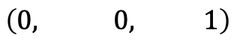
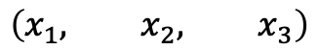
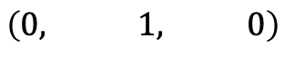
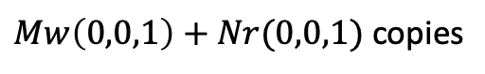

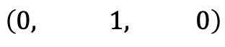
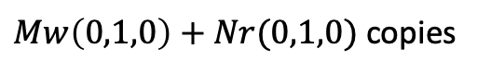
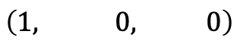
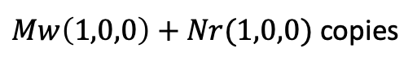
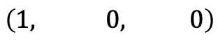
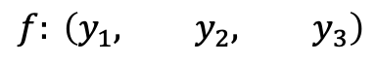
Correct Analysis BLP+Affine
Assumption: Pol(A,B) has infinitely many symmetric polymorphisms.
Pick M sufficiently large, multiple of all denominators of BLP.
Pick L sufficiently large such that $f:A^{L}→B$ is in Pol(A,B). Pick N = L-M.
Look at the clause $R^{A}\left(x_{1},x_{2},x_{3}\right)$
$$\left(x_{1}, x_{2}, x_{3}\right)$$
$$\left(1, 0, 0\right)$$
$Mw\left(1,0,0\right)+Nr(1,0,0)$ copies
$$\left(1, 0, 0\right)$$
$$\left(0, 1, 0\right)$$
$Mw\left(0,1,0\right)+Nr(0,1,0)$ copies
$$\left(0, 1, 0\right)$$
$$\left(0, 0, 1\right)$$
$Mw\left(0,0,1\right)+Nr(0,0,1)$ copies
$$f: \left(y_{1}, y_{2}, y_{3}\right)$$
Proof idea: by the consistency equations for BLP+Affine, the $y_{i}$’s are consistent.

Slide 29
Agenda
Overall goal: Understand a simple, principle algorithm for a broad class of (Promise) CSPs.
Promise CSPs and their polymorphisms
The Basic Linear Programming and Affine Relaxations
Analysis for symmetric polymorphisms
Characterizing Power
Concluding Remarks.

Slide 30
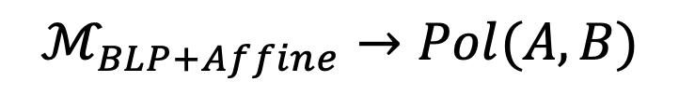
How powerful is BLP+Affine?
Theorem: BLP+Affine correctly solves PCSP(A,B) if and only if Pol(A,B) has infinitely many block-symmetric polymorphisms with two blocks.
The heart of this theorem is there is an algebraic characterization of when the BLP+Affine algorithm works.
$$ℳ_{BLP+Affine}→Pol(A,B)$$

Slide 31
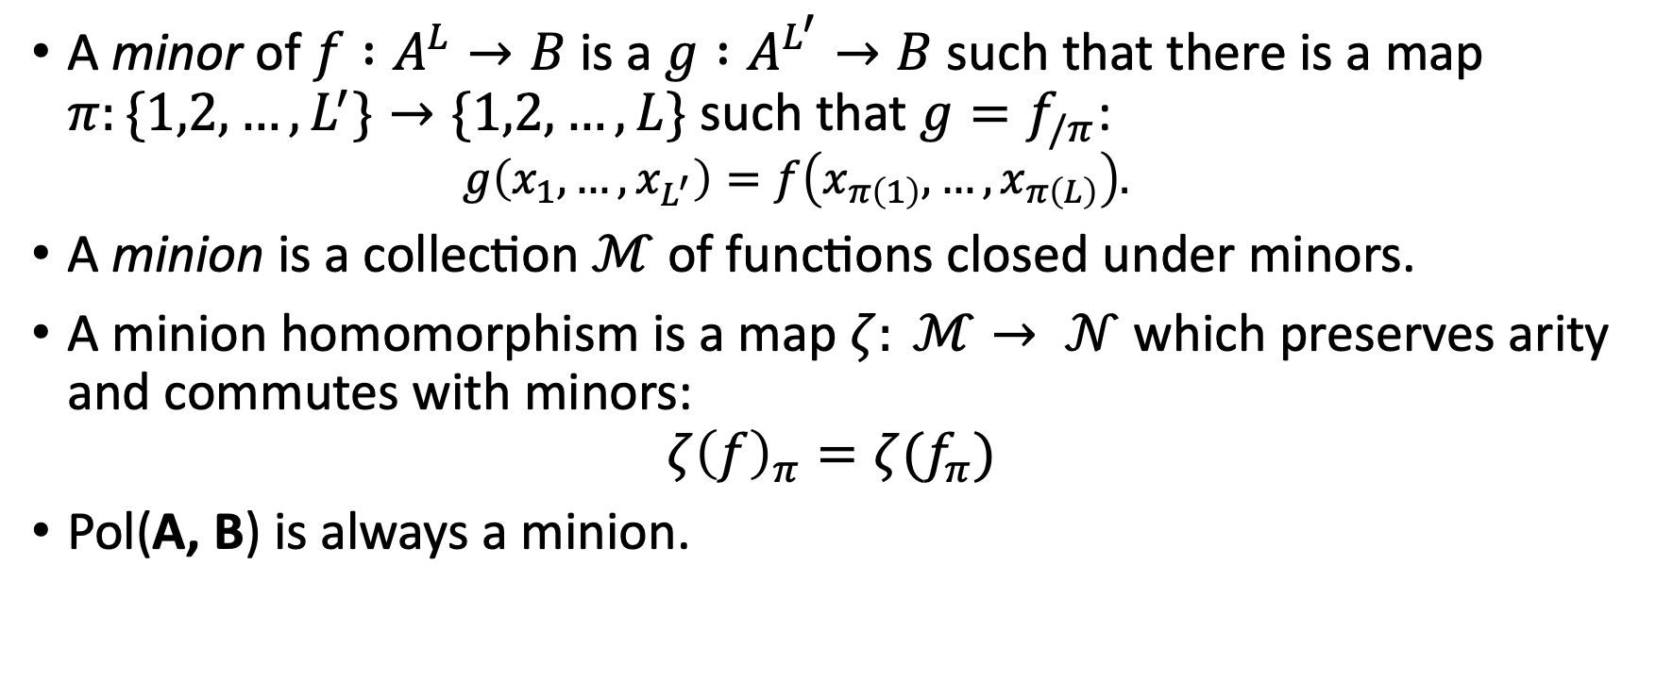
Minion Homomorphism
A minor of $f :A^{L}→B$ is a $g :A^{L^{′}}→B$ such that there is a map $π:\{1,2,…,L^{′}\}→\{1,2,…,L\}$ such that $g=f_{/π}$:
$$g\left(x_{1},…, x_{L^{′}}\right)=f\left(x_{π\left(1\right)}, …,x_{π\left(L\right)}\right).$$
A minion is a collection $ℳ$ of functions closed under minors.
A minion homomorphism is a map $ζ: ℳ→ 𝒩$ which preserves arity and commutes with minors:
$$ζ{\left(f\right)}_{π}=ζ(f_{π})$$
Pol(A, B) is always a minion.

Slide 32
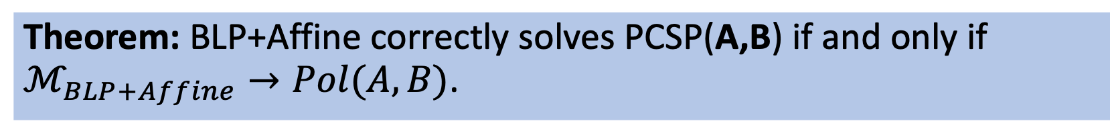
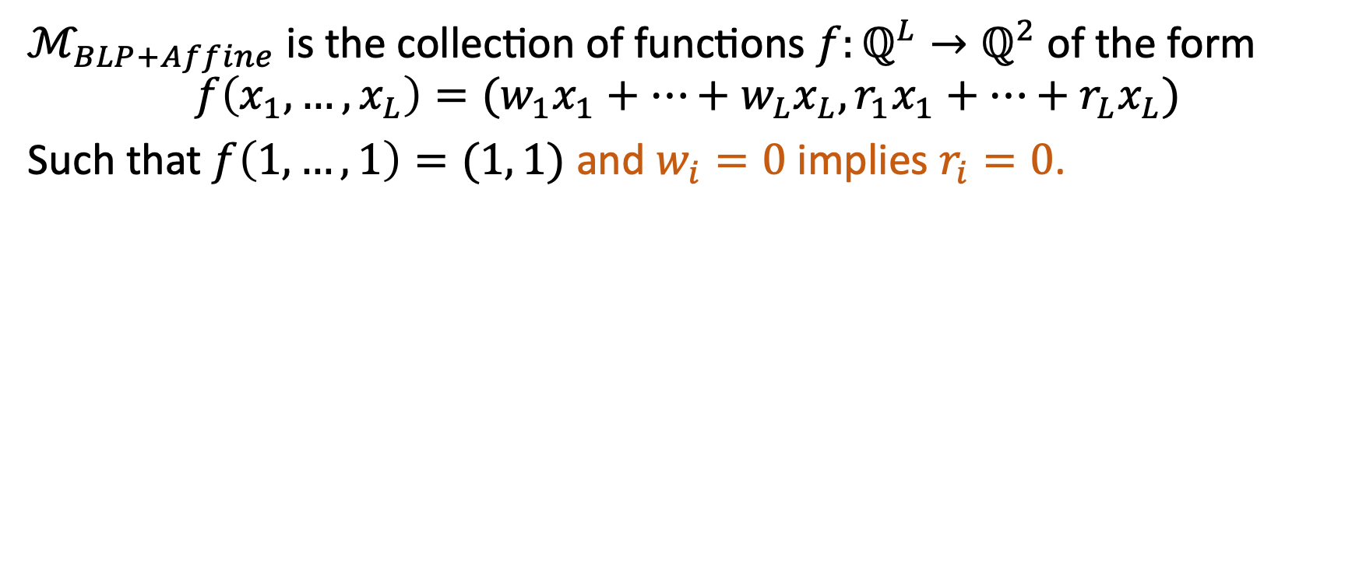
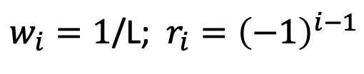
BLP+Affine minion
$ℳ_{BLP+Affine}$ is the collection of functions $f:ℚ^{L}→ℚ^{2}$ of the form
$$f\left(x_{1},…, x_{L}\right)=(w_{1}x_{1}+…+w_{L}x_{L}, r_{1}x_{1}+…+r_{L}x_{L})$$
Such that $f\left(1,…,1\right)=(1, 1)$ and $w_{i}=0$ implies $r_{i}=0$.
Theorem: BLP+Affine correctly solves PCSP(A,B) if and only if $ℳ_{BLP+Affine}→Pol(A,B)$.
Theorem: BLP+Affine correctly solves PCSP(A,B) if and only if Pol(A,B) has infinitely many block-symmetric polymorphisms with two blocks.
$w_{i}=1$/L; $r_{i}={\left(−1\right)}^{i−1}$

Slide 33
Agenda
Overall goal: Understand a simple, principle algorithm for a broad class of (Promise) CSPs.
Promise CSPs and their polymorphisms
The Basic Linear Programming and Affine Relaxations
Analysis for symmetric polymorphisms
Characterizing Power
Concluding Remarks.

Slide 34
Corollary: All-in-one Algorithm for Schaefer’s Theorem
Schaefer’s Theorem says that any tractable Boolean CSP has one of the following polymorphisms:
Constant 0 → Constant 0 of all arities
Constant 1 → Constant 1 of all arities
OR of two bits → OR of all arities
AND of two bits → AND of all arities
MAJORITY of three bits → MAJORITY of all odd arities
XOR of three bits → XOR of all odd arities

Slide 35
Negative Result (due to Jakub Opršal)
Fact: BLP + Affine cannot solve every tractable (P)CSP
$$R=\left\{\left(0, 1\right), \left(1, 0\right)\right\} ∪\{\left(2, 3\right),\left(3,4\right),(4,2)\}$$
0
2
1
4
3

Slide 36
Future of PCSP
Better analysis of existing algorithms:
Bounded width/Sherali-Adams / Lasserre hierarchies
+ Affine?
Bulatov/Zhuk algorithms
Aiming for broader families of polymorphisms:
Cyclic
Transitive symmetric
Closing gap between algorithms/hardness

Slide 37
Thank you!
Special thanks to Libor Barto, Andrei Krokhin, and Jakub Opršal.

